Slide 1
D2iQ Kubernetes Workshop

Slide 2
Introductions

Slide 3
About D2iQ
Established in 2013 as Mesosphere in San Francisco
Raised $250M in funding
Track record of building large scale Cloud Native platforms, reaching 10,000s of nodes on-prem, in public cloud and hybrid
Deep expertise in data services including Kafka, Spark, Cassandra, Elastic and HDFS
Largest private Kubernetes company. Contributors since 2014

Slide 4
About the Audience
Show your hands
Developer/User of kubernetes?
Deployer/Operator of kubernetes?
Are you in a devops role and responsible for both?
Are you relatively new to kubernetes (early in journey)?
Do you have kubernetes in production?
What is your biggest challenge?

Slide 5
Introduction to Kubernetes

Slide 6
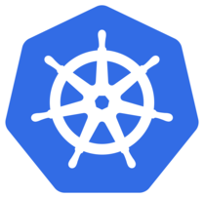
What is Kubernetes?
Kubernetes (commonly stylized as k8s^{[3]}) is an open-source container-orchestration system for automating application deployment, scaling, and management.^{[4]} It was originally designed by Google, and is now maintained by the Cloud Native Computing Foundation. It aims to provide a "platform for automating deployment, scaling, and operations of application containers across clusters of hosts".^{[3]}
*Wikipedia

Slide 7

What Kubernetes is not
Not a traditional, all-inclusive Platform as a Service (PaaS) system
Operates containers, not the hardware level
Provides some features like a PaaS:
Deployment
Scaling
Load Balancing
Logging and Monitoring
Not Monolithic - pluggable to provide optionality
Provides components for building developer platforms
Preserves user choice and flexibility where important
Notes:
Platform as a Service (PaaS) or Application Platform as a Service (aPaaS) or platform-based service is a category of cloud computing services that provides a platform allowing customers to develop, run, and manage applications without the complexity of building and maintaining the infrastructure typically associated with developing and launching an app.

Slide 8

Project Stats
Over 55,000 stars on Github
2,200+ Contributors to K8s Core
Most discussed Repository by a large margin
70,000+ members of Slack channel
September 2019

Slide 9

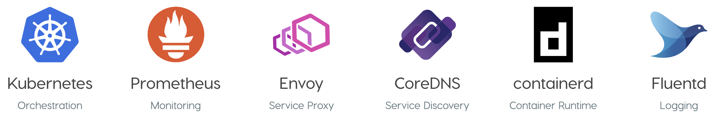
Who Manages Kubernetes
One of many “Graduated” projects managed by the CNCF: a child entity of the Linux Foundation that operates as a vendor neutral governance group.
https://www.cncf.io/projects/
Notes:
Graduation Stage:
Have committers from at least two organizations.
Have achieved and maintained a Core Infrastructure Initiative Best Practices Badge.
Have completed an independent and third party security audit with results published of similar scope and quality as the following example (including critical vulnerabilities addressed): https://github.com/envoyproxy/envoy#security-audit and all critical vulnerabilities need to be addressed before graduation.
Adopt the CNCF Code of Conduct.
Explicitly define a project governance and committer process. This preferably is laid out in a GOVERNANCE.md file and references an OWNERS.md file showing the current and emeritus committers.
Have a public list of project adopters for at least the primary repo (e.g., ADOPTERS.md or logos on the project website).
Receive a supermajority vote from the TOC to move to graduation stage. Projects can attempt to move directly from sandbox to graduation, if they can demonstrate sufficient maturity. Projects can remain in an incubating state indefinitely, but they are normally expected to graduate within two years.

Slide 10
The Architecture
Kubernetes has a complex architecture of components (Distributed System)
The components are divided in 2 categories:
Management Plane
Worker
The components are deployed across nodes/machines and make a Cluster

Slide 11
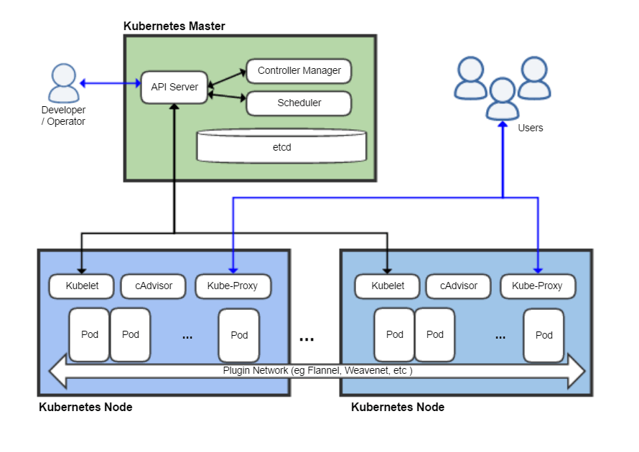
*Wikipedia

Slide 12










Kubernetes Is More Than Just “Kubernetes”
There is more to running a Kubernetes platform and deploying Cloud Native applications than simply installing Kubernetes
Install
Container Runtime
Monitoring
Logging
Debugging
There are many components to integrate just to get Kubernetes up and running
That’s before you even start using it to run containerized workloads or connect your CI/CD pipeline
Service Discovery
Service Mesh
Storage
Networking
Application Management

Slide 13
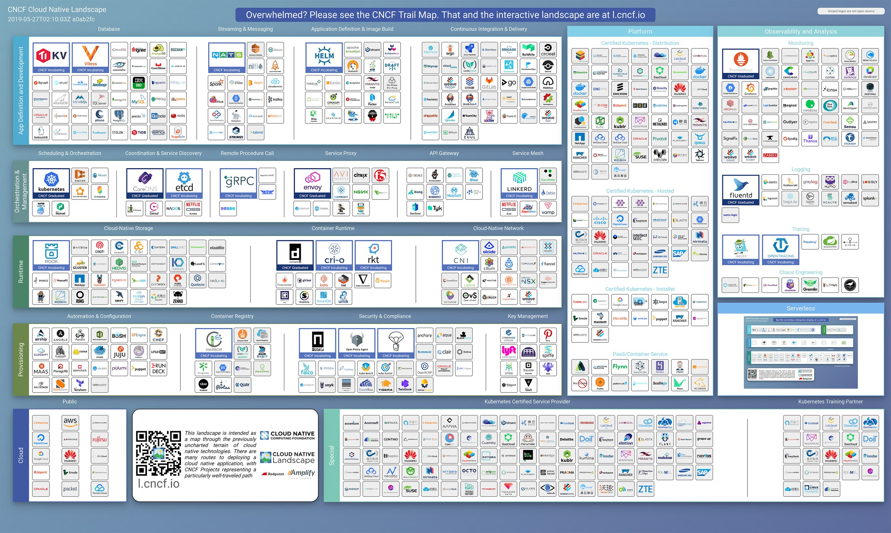
CNCF Landscape

Slide 14
Why Kubernetes

Slide 15

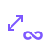

Business Outcomes Are Driving Kubernetes Adoption
Faster
Deployment
Improved Scalability
Cloud Portability
Source: CNCF Survey August 2018 (n=2,400)
Notes:
Goal
Reference CNCF Survey results of above primary goals.
ASK prospect what THEIR goals are
Organizations see the benefits of Cloud Native practices and want to take advantage within their own business.
While Faster Time to Deployment is the most attractive benefit, both Cloud Portability and Improved Scalability over existing enterprise technologies are key business drivers
Faster Deployment: 50% Improved Scalability: 45% Cloud Portability: 42%
Source: CNCF Survey August 2018 (n=2,400)

Slide 16
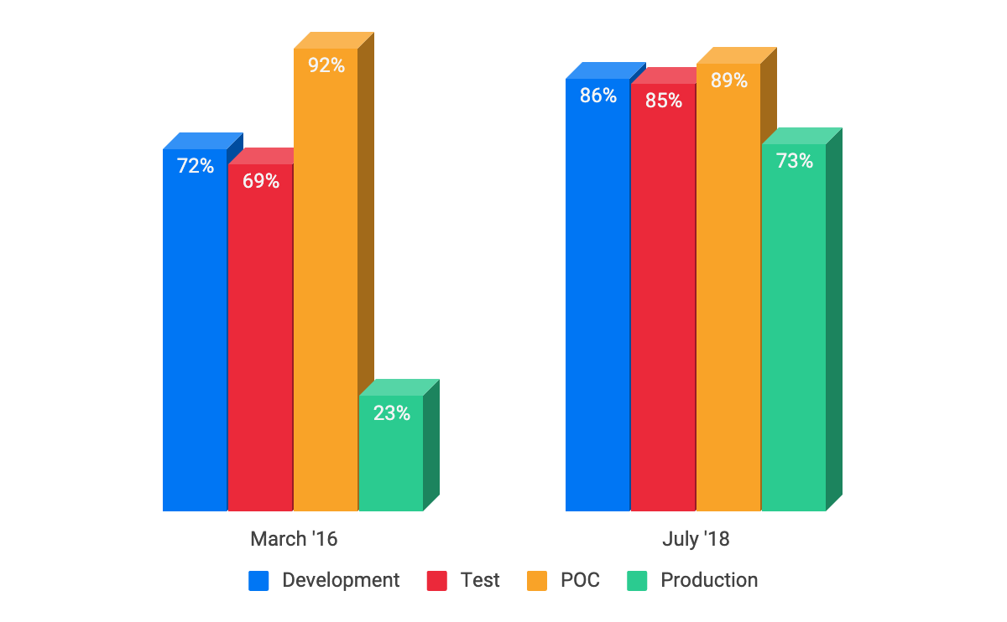
Kubernetes Adoption Is Skyrocketing
Kubernetes is seen by developers as the best platform for container based cloud-native workloads
Organizations are rapidly adopting Kubernetes for their container and cloud-native initiatives
Source: CNCF Survey August 2018 (n=2,400)
Notes:
https://www.cncf.io/blog/2018/08/29/cncf-survey-use-of-cloud-native-technologies-in-production-has-grown-over-200-percent/
n = 2,400
Growth
While Dev, Test and PoC uses of Containers has increased steadily, Production deployments have increased from 23% - 73%
22% running 1 cluster in Production
40% running 2 - 5 clusters in Production
14% running 6 - 10 clusters in Production
13% running 50+ clusters in Production
Why Cloud Native?
Faster deployment time (50%)
Improved scalability (45%)
Cloud portability (42%)
Challenges
Cultural Changes with Development Team (41%)
Complexity (40% up from 35%)
Lack of Training (40%)
Security (38% down from 43%)
Monitoring (34% down from 38%)
Storage (30% down from 41%) ← This is good for us, CSI
Networking (30% down from 38%)

Slide 17
Why now?
Build and Deploy Faster (Iterate)
Production Grade Maturity
Competitive Differentiation in YOUR market
Massive Adoption in the Industry (new form factor)
ISVs moving to Kubernetes - YOUR software vendors
Next step of maturity with Cloud Adoption -> Cloud Native!
Capture NEW markets
Outrun the competition

Slide 18
Kubernetes Deployment

Slide 19
Kubernetes Complexity

Slide 20
Kubernetes Complexity
Cloud Provider

Slide 21
Kubernetes Complexity
Container Platform
& Resource Manager
Cloud Provider

Slide 22
Kubernetes Complexity
Container Platform
& Resource Manager
Cloud Provider
Training

Slide 23
Kubernetes Complexity
Monitoring
Container Platform
& Resource Manager
Cloud Provider
Training

Slide 24
Kubernetes Complexity
Monitoring
Container Platform
& Resource Manager
Log View and Search
Cloud Provider
Training

Slide 25
Kubernetes Complexity
Monitoring
Container Platform
& Resource Manager
Log View and Search
Debugging
Cloud Provider
Training

Slide 26
Kubernetes Complexity
Monitoring
Container Platform
& Resource Manager
Service Discovery,
Mesh and Networking
Log View and Search
Debugging
Cloud Provider
Training

Slide 27
Kubernetes Complexity
Monitoring
Container Platform
& Resource Manager
Service Discovery,
Mesh and Networking
Log View and Search
Debugging
Cloud Provider
Training
Kubernetes Installer

Slide 28
Kubernetes Complexity
Monitoring
Container Platform
& Resource Manager
Service Discovery,
Mesh and Networking
Log View and Search
Container Runtime
Debugging
Cloud Provider
Training
Kubernetes Installer

Slide 29
Kubernetes Complexity
Monitoring
Container Platform
& Resource Manager
Service Discovery,
Mesh and Networking
Log View and Search
Container Runtime
Storage
Debugging
Cloud Provider
Training
Kubernetes Installer

Slide 30
Kubernetes Complexity
Manage
Application
Monitoring
Container Platform
& Resource Manager
Service Discovery,
Mesh and Networking
Log View and Search
Container Runtime
Storage
Debugging
Cloud Provider
Training
Kubernetes Installer

Slide 31
Kubernetes Complexity
Install Application
Packages
Manage
Application
Monitoring
Container Platform
& Resource Manager
Service Discovery,
Mesh and Networking
Log View and Search
Container Runtime
Storage
Debugging
Cloud Provider
Training
Kubernetes Installer

Slide 32
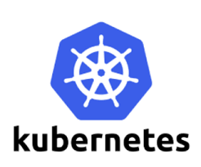



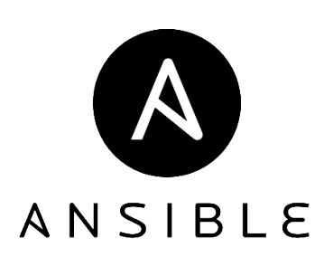




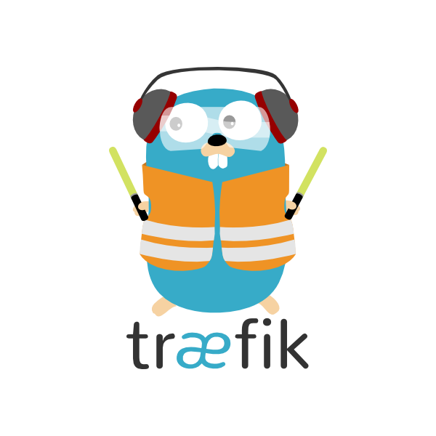

Keeping up and securing a fast moving ecosystem is a real challenge
Within 6 Months
12* / 4**
33* / 5**
9* / 2**
37^ Vulnerabilities
17* / 3**
18* / 2**
11* / 3**
187^ Releases
21* / 7**
8* / 3**
8* / 5**
* Total number of releases between Dec-2018 - June-2019
** Releases with security vulnerabilities between Dec-2018 - June-2019 ^ Includes additional technologies not listed

Slide 33
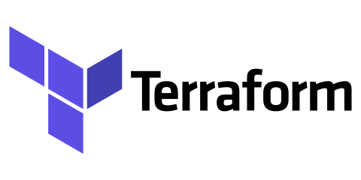
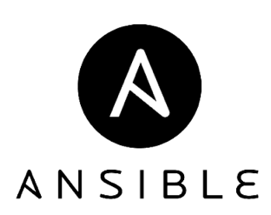
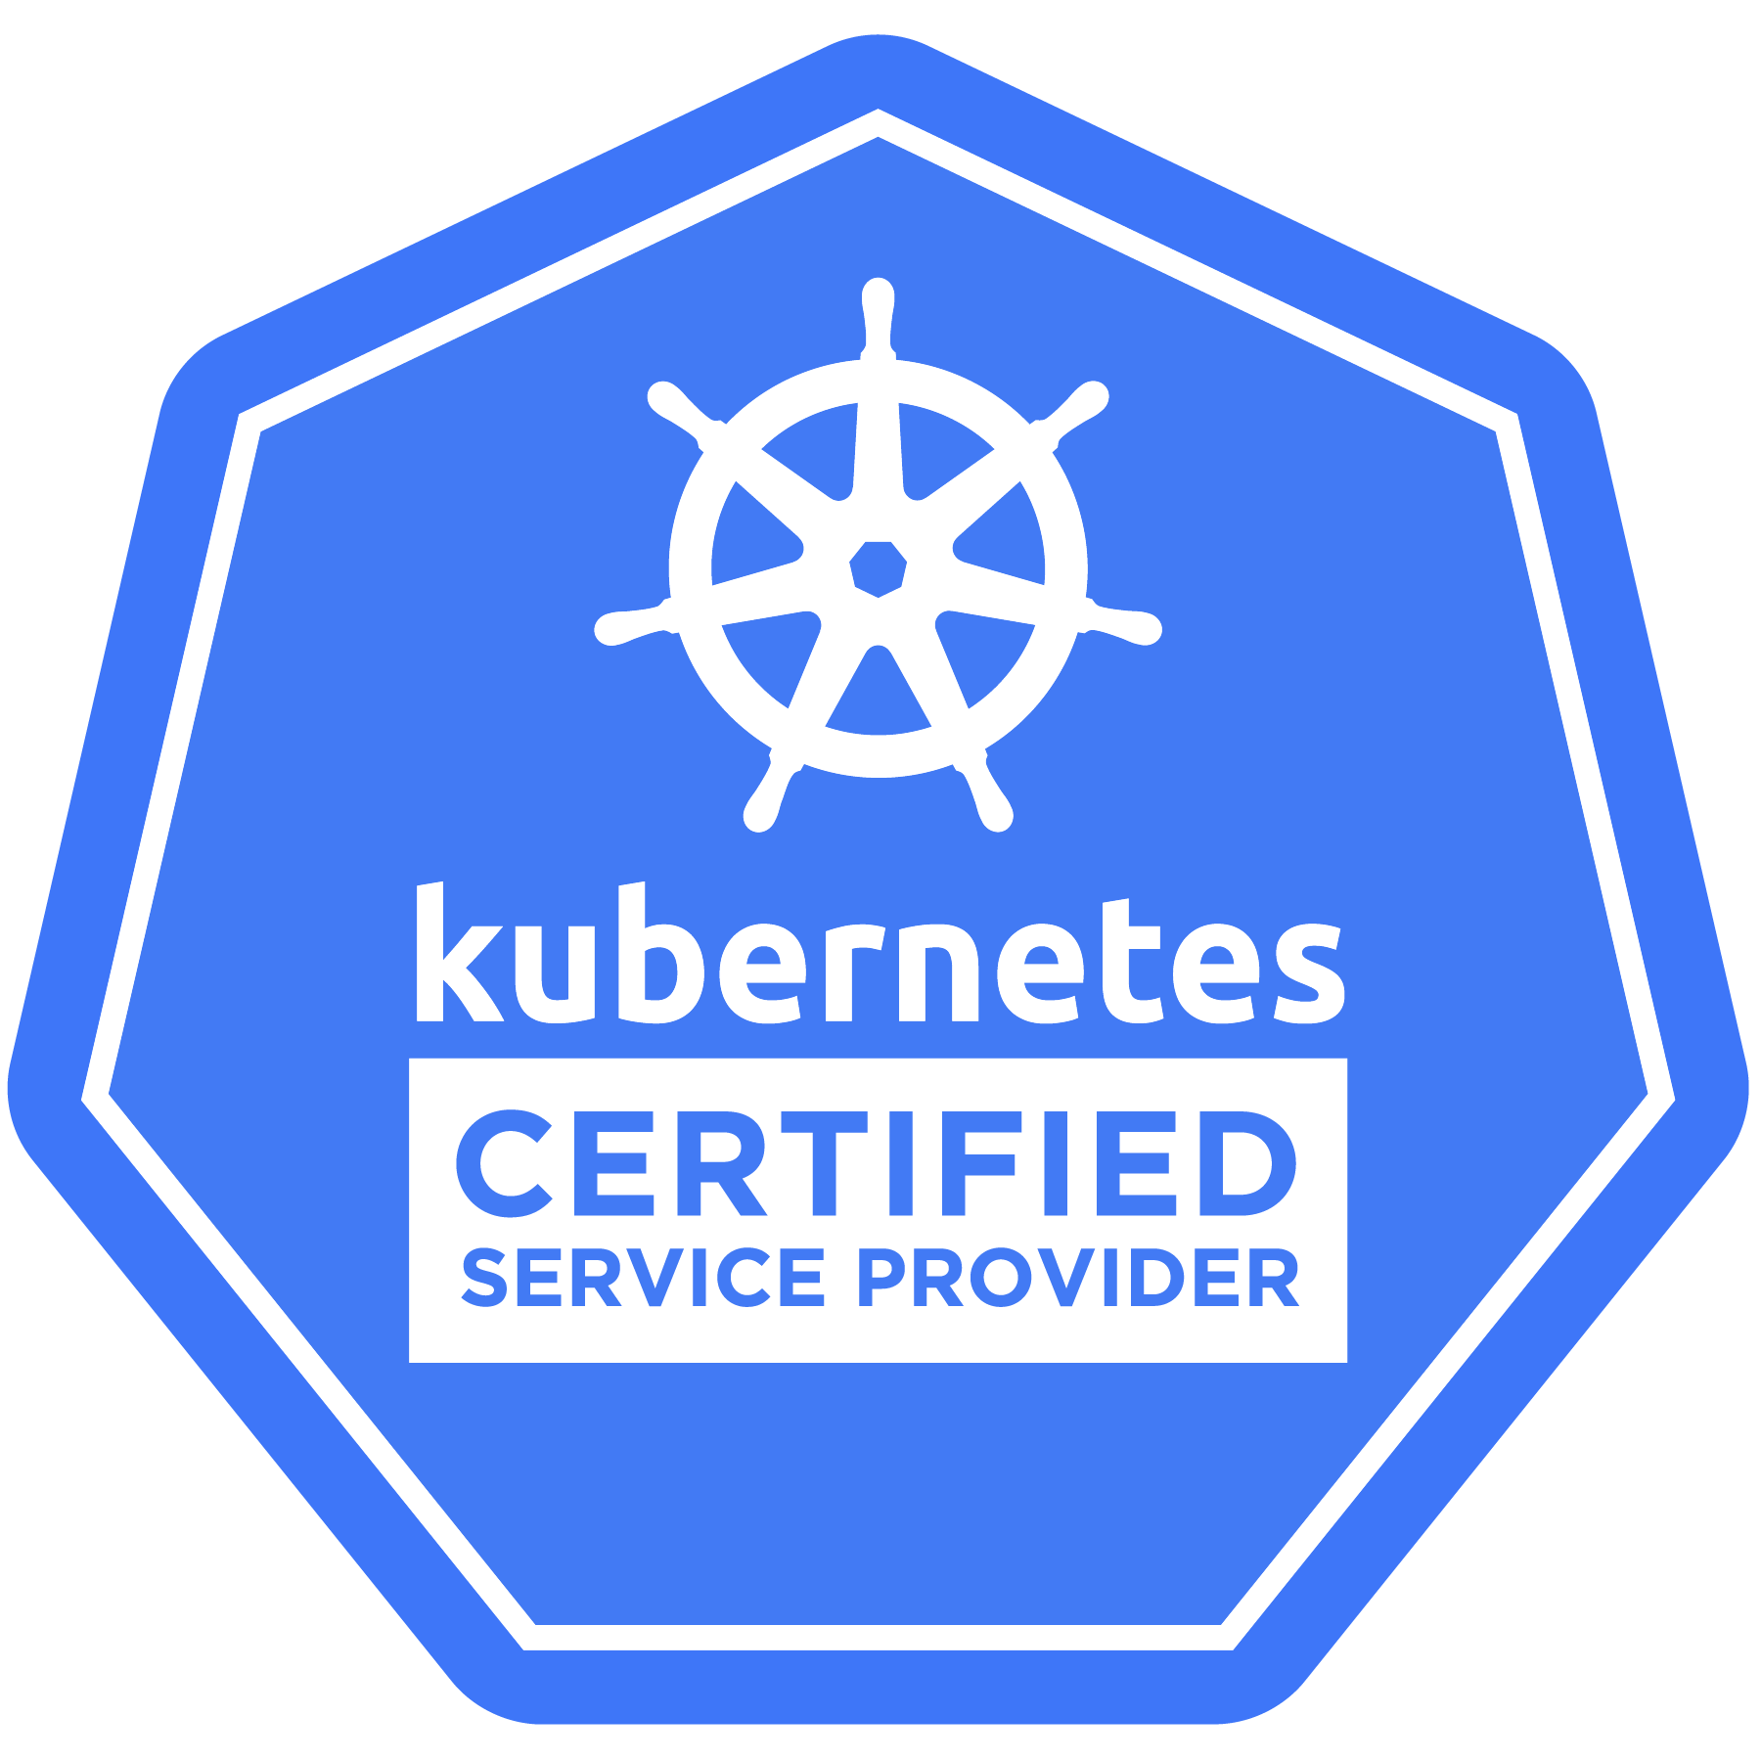
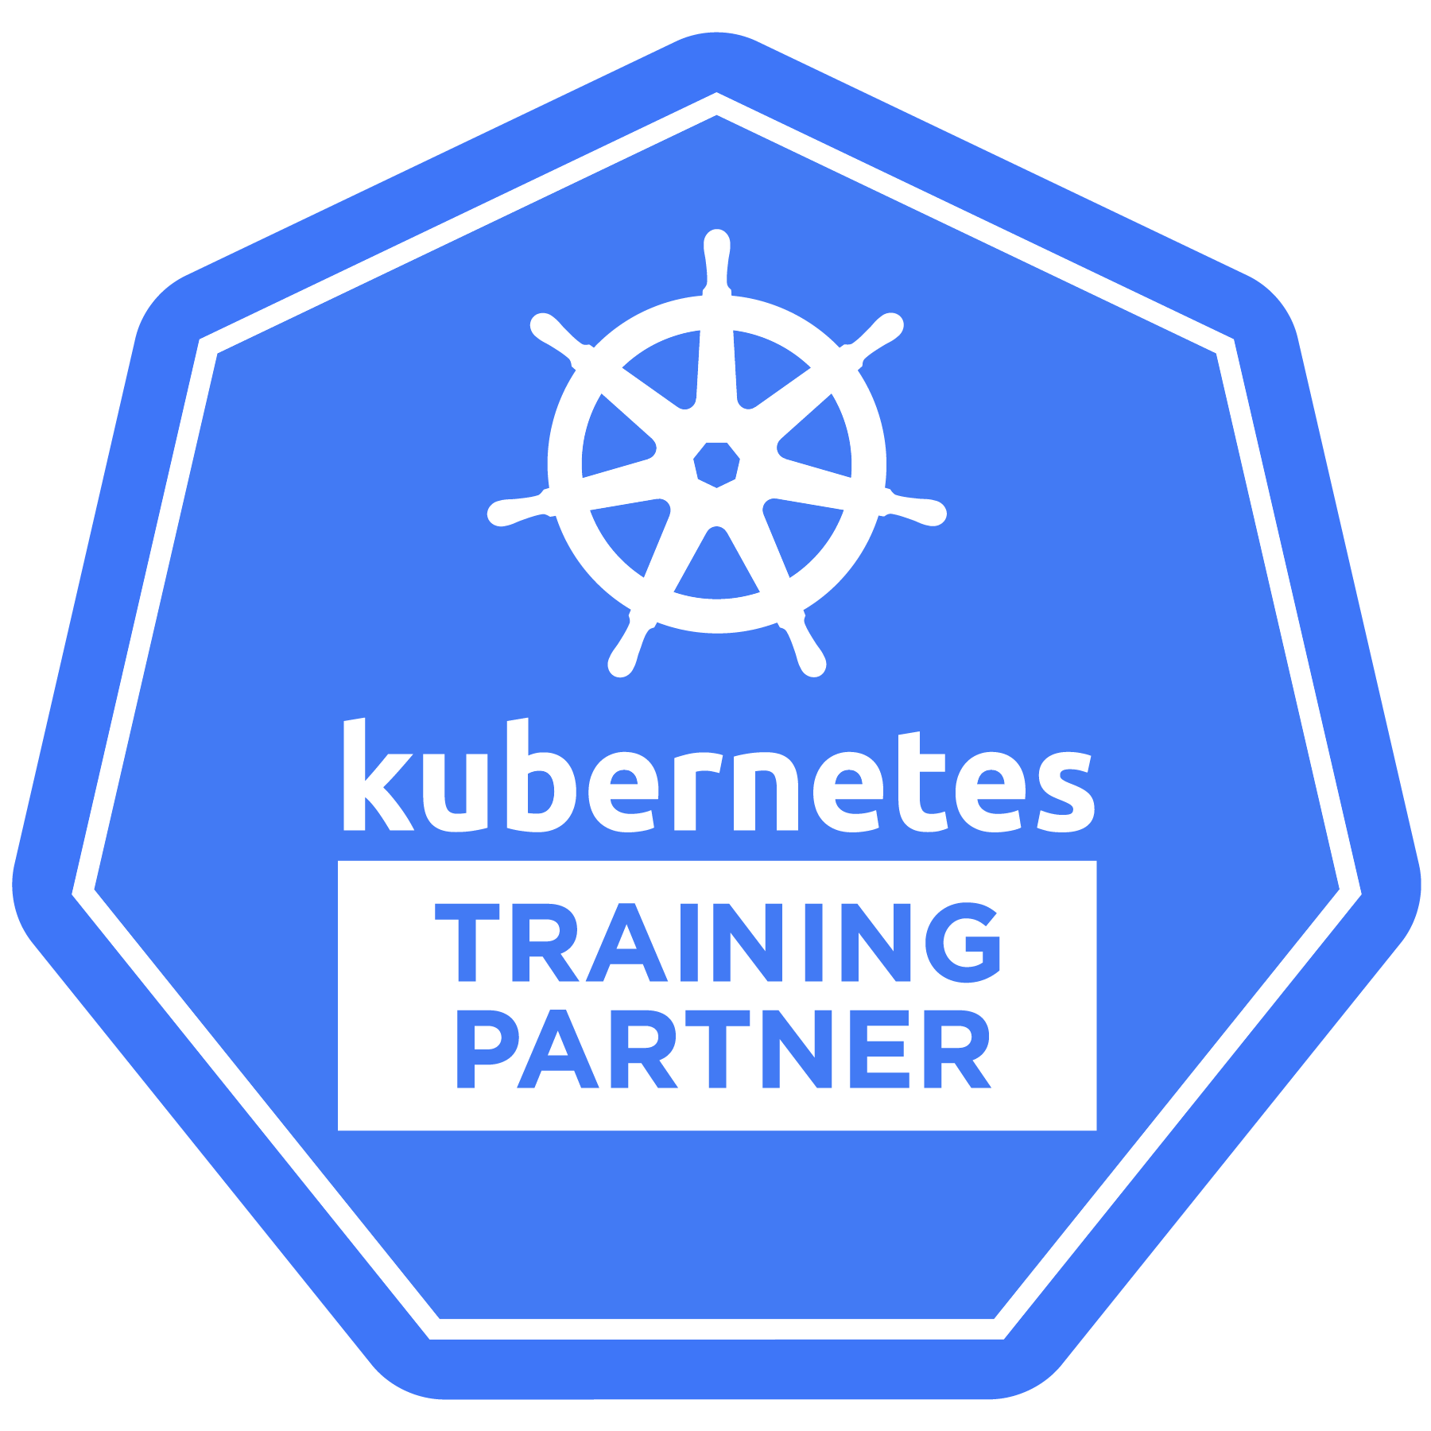
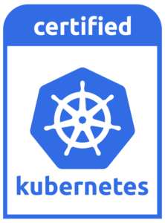
D2iQ Konvoy Delivers Certified Integrated Automation
Industry Standard Provisioning and Automated Configuration Management
Logging (Fluentbit, Elastic,
Kibana)
Monitoring (Prometheus,
Grafana)
PURE KUBERNETES
Disaster
Recovery (Velero)
ServiceMesh
Control Plane | etcd Containerd | Ansible
Calico | Terraform
CNCF Certified Kubernetes Partner
Ingress (Traefik)
DNS Service (CoreDNS)
Load Balancer (Metal-LB)
ADD-ONS

Slide 34
D2iQ Konvoy Delivers Certified Integrated Automation
Industry Standard Provisioning and Automated Configuration Management
Scale
Testing
Ecosystem
Integration
Logging (Fluentbit, Elastic,
Kibana)
Monitoring (Prometheus,
Grafana)
PURE KUBERNETES
Cloud
Integration
Security
Testing
Disaster
Recovery (Velero)
ServiceMesh
Control Plane | etcd Containerd | Ansible
Calico | Terraform
CNCF Certified Kubernetes Partner
Ingress (Traefik)
DNS Service (CoreDNS)
Load Balancer (Metal-LB)
Multi-OS
Support
Bare-metal
ADD-ONS
ECOSYSTEM & IAAS

Slide 35

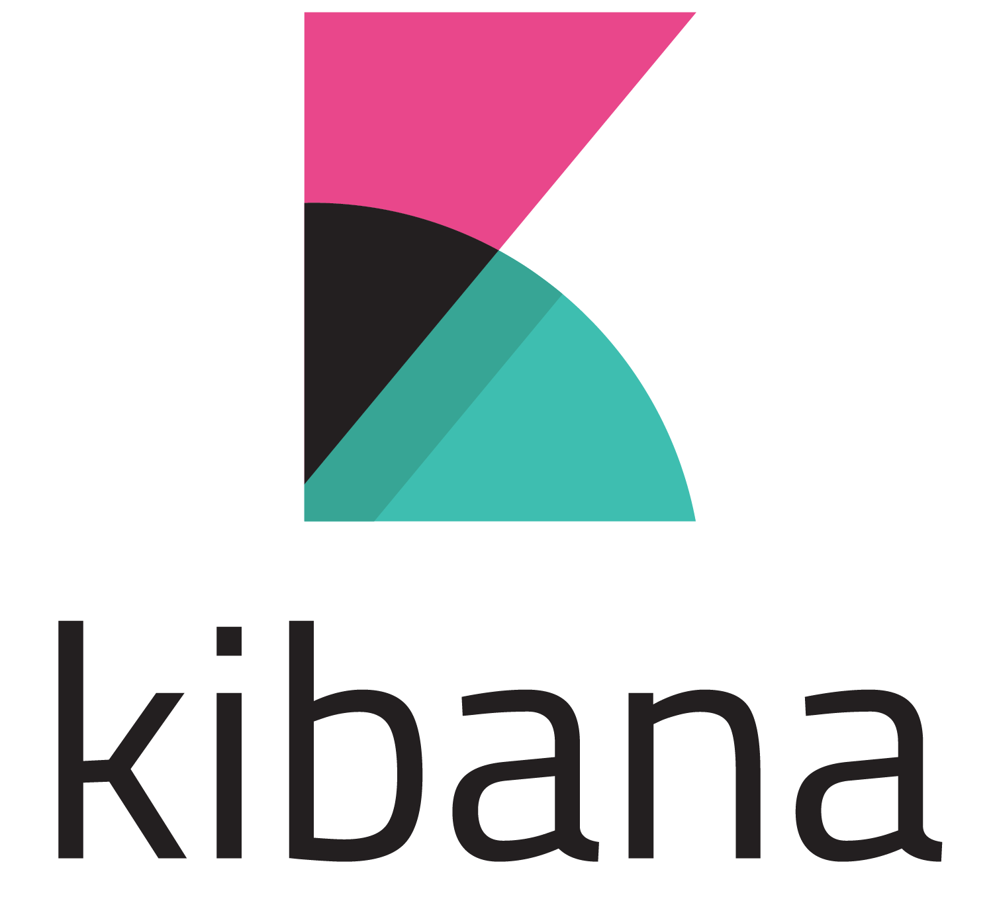
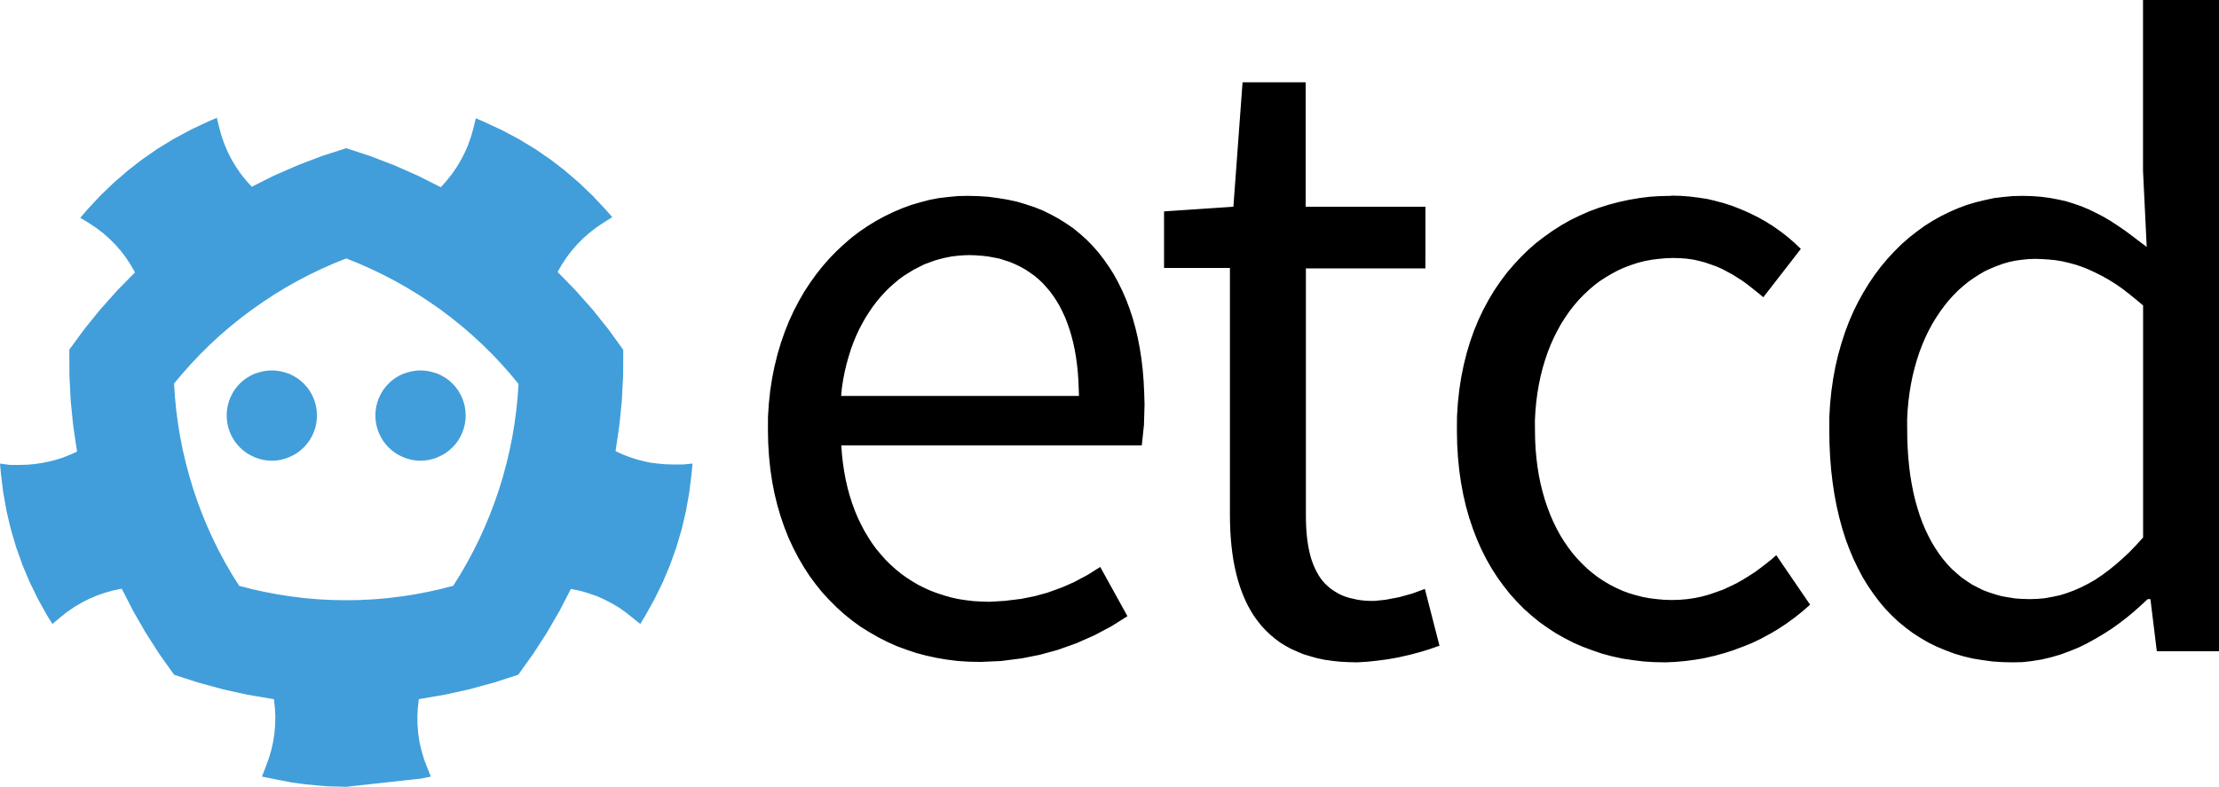
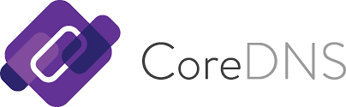





Konvoy - A Complete Cloud Native Distribution
Infrastructure Automation
Kubernetes
Core Add-Ons
Deploy, Monitor, Log
kubeadm

Slide 36
Kubernetes Deployment
Lab
Deploying a Kubernetes Cluster with Konvoy
https://github.com/mesosphere/konvoy-training

Slide 37
Kubernetes Basics

Slide 38
Pods
Atomic unit or smallest “unit of work”of Kubernetes.
Foundational building block of Kubernetes Workloads.
Pods are one or more containers that share volumes and a network namespace

Slide 39
Pod Container Attributes (there are more)
apiVersion: v1
kind: Pod
metadata:
name: basic-pod-demo
spec:
containers:
- name: basic-pod-demo
image: debian
env:
- name: MYVAR
value: isAwesome
ports:
- containerPort: 22
name: myport
protocol: TCP
command: ["/bin/sh"]
args: ["-c", "while true; do echo hello; sleep 10;done"]
name - The name of the container
image - The container image
ports - array of ports to expose. Can be granted a friendly name and protocol may be specified
env - array of environment variables
command - Entrypoint array (equiv to Docker ENTRYPOINT)
args - Arguments to pass to the command (equiv to Docker CMD)

Slide 40
Replica Set
Primary method of managing pod replicas and their lifecycle
Replicas are copies of a pod needed for service scaling and high availability
Includes their scheduling, scaling, and deletion.
Their job is simple: Always ensure the desired number of pods are running

Slide 41
Deployments
apiVersion: apps/v1
kind: Deployment
metadata:
name: nginx-deployment
labels:
app: nginx
spec:
replicas: 3
selector:
matchLabels:
app: nginx
template:
metadata:
labels:
app: nginx
spec:
containers:
- name: nginx
image: nginx:1.7.9
ports:
- containerPort: 80
Declarative method of managing Pods via ReplicaSets.
Provide rollback functionality and update control.

Slide 42
Kubernetes Networking

Slide 43
Understanding Kubernetes Services
Unified method of accessing the exposed workloads of Pods
Durable resource (unlike Pods)
static cluster-unique IP
static namespaced DNS name
Uses kube-proxy to provide simple load-balancing
kube-proxy acts as a daemon that creates local entries in the host’s iptables for every service
<service name>.<namespace>.svc.cluster.local

Slide 44
Service Types
There are 4 major service types:
ClusterIP (default)
NodePort
LoadBalancer
ExternalName

Slide 45
ClusterIP Service
apiVersion: v1
kind: Service metadata:
name: example-prod
spec:
selector:
app: nginx
env: prod
ports:
- protocol: TCP
port: 80
targetPort: 80
ClusterIP services exposes a service on a strictly cluster internal virtual IP
Notes:
ClusterIP: Exposes the Service on a cluster-internal IP. Choosing this value makes the Service only reachable from within the cluster. This is the default ServiceType.

Slide 46
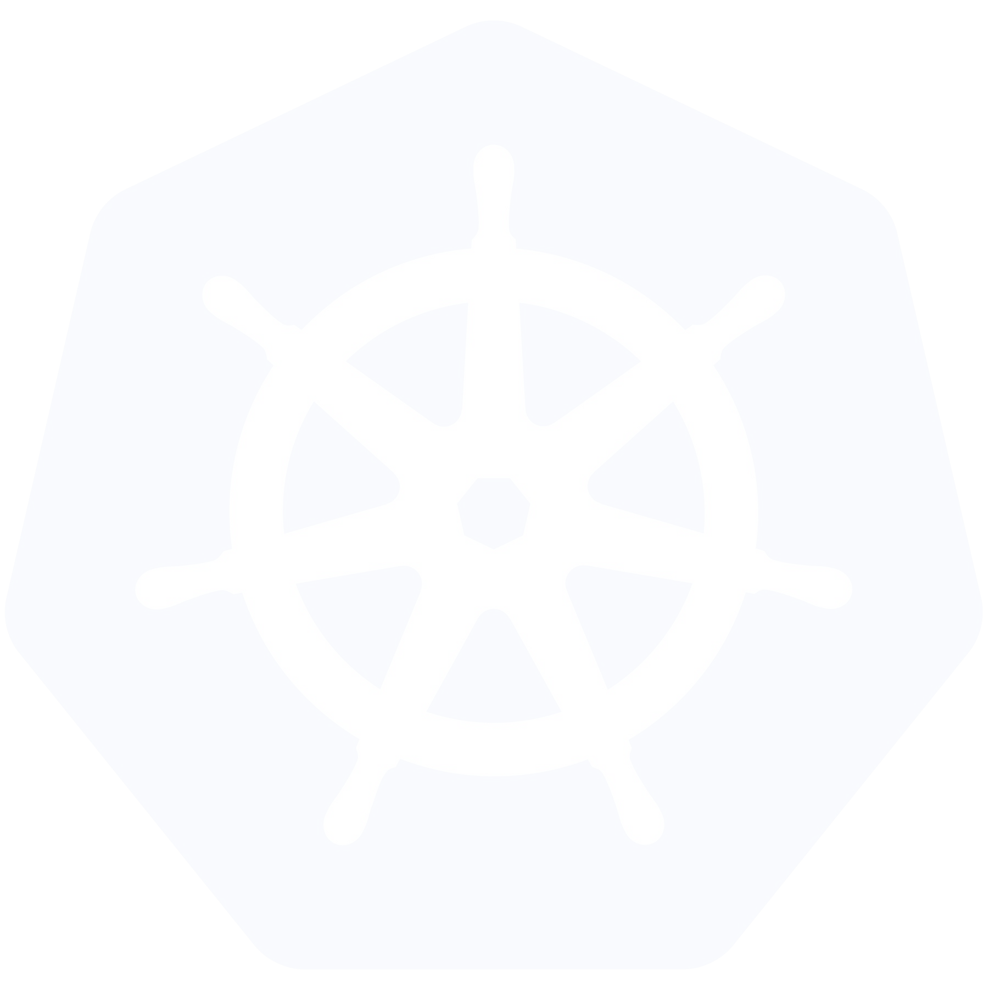
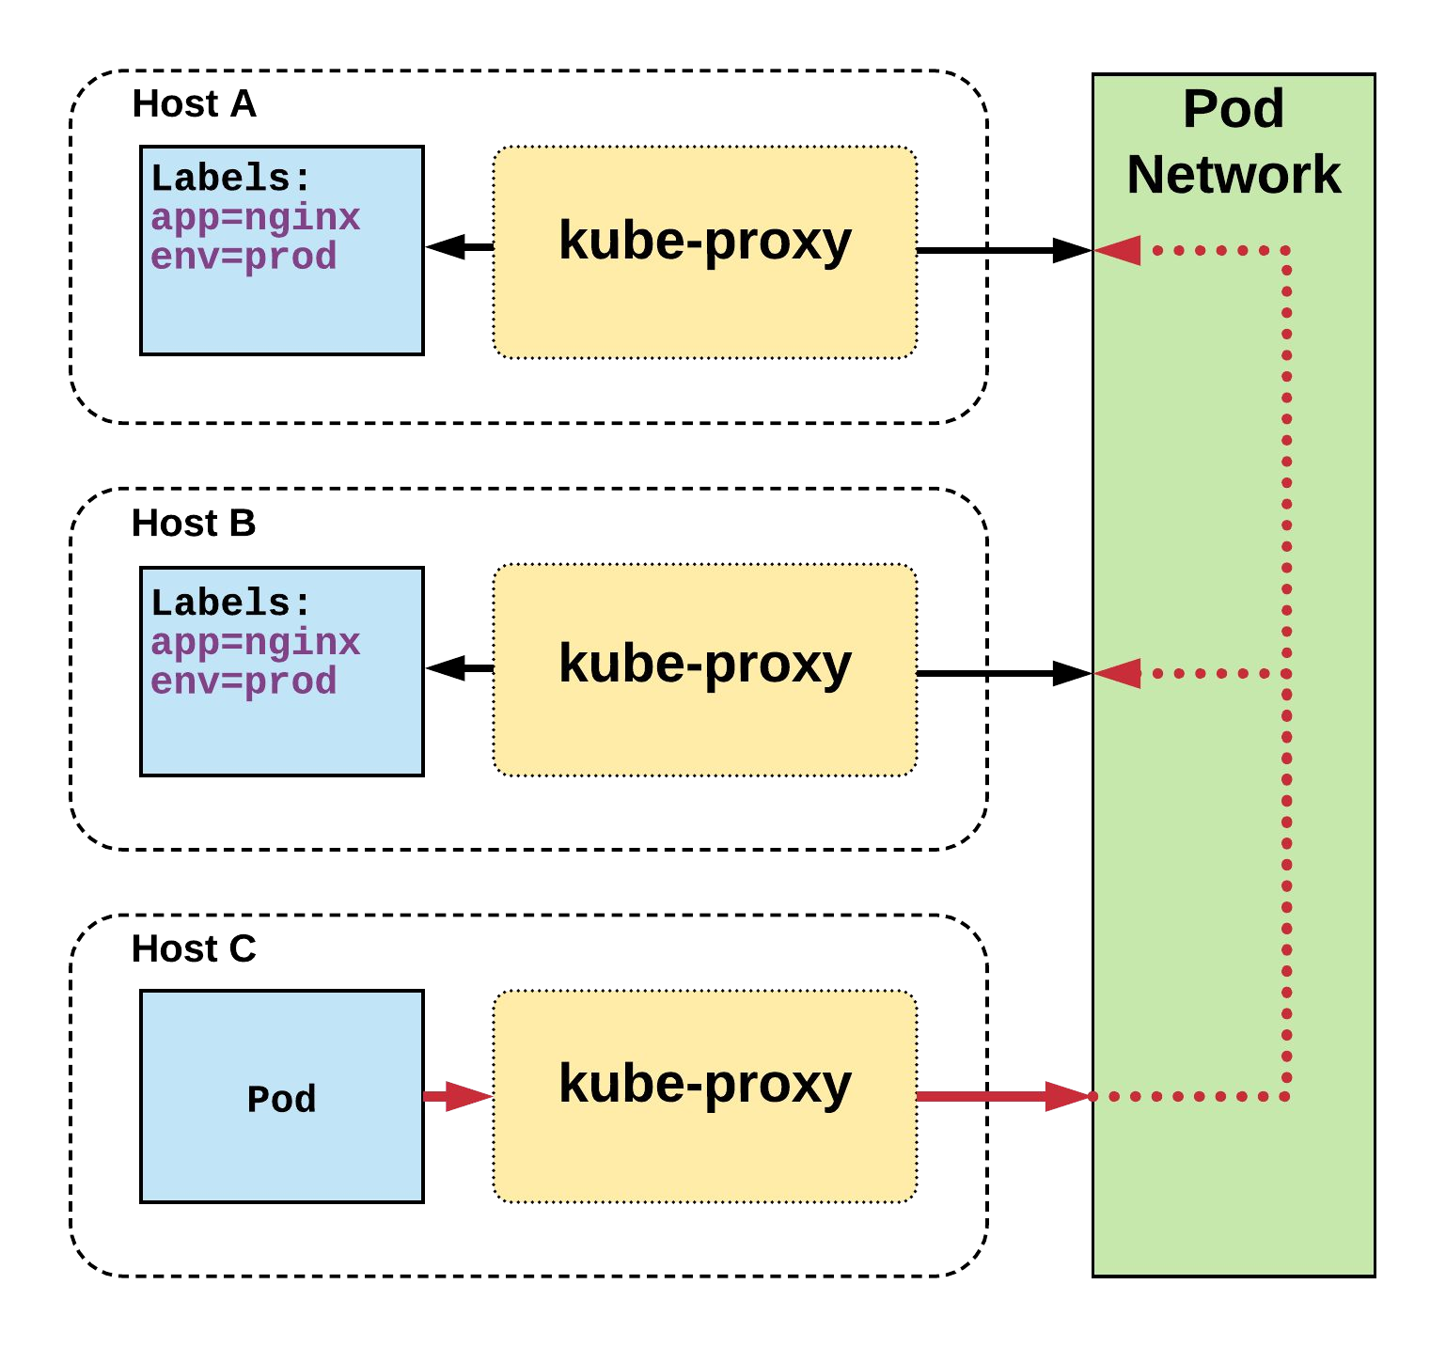
ClusterIP Service
Name: Selector: Type:
IP:
Port: TargetPort: Endpoints:
example-prod app=nginx,env=prod ClusterIP 10.96.28.176
<unset> 80/TCP 80/TCP
10.255.16.3:80,
10.255.16.4:80
/ # nslookup example-prod.default.svc.cluster.local
Name: example-prod.default.svc.cluster.local
Address 1: 10.96.28.176 example-prod.default.svc.cluster.local

Slide 47
NodePort Service
apiVersion: v1
kind: Service metadata:
name: example-prod
spec:
type: NodePort selector:
app: nginx
env: prod
ports:
- nodePort: 32410
protocol: TCP
port: 80
targetPort: 80
NodePort services extend the
ClusterIP service.
Exposes a port on every node’s IP
Port can either be statically defined, or dynamically taken from a range between
30000-32767
Notes:
NodePort: Exposes the Service on each Node’s IP at a static port (the NodePort). A ClusterIP Service, to which the NodePort Service routes, is automatically created. You’ll be able to contact the NodePort Service, from outside the cluster, by requesting <NodeIP>:<NodePort>.

Slide 48
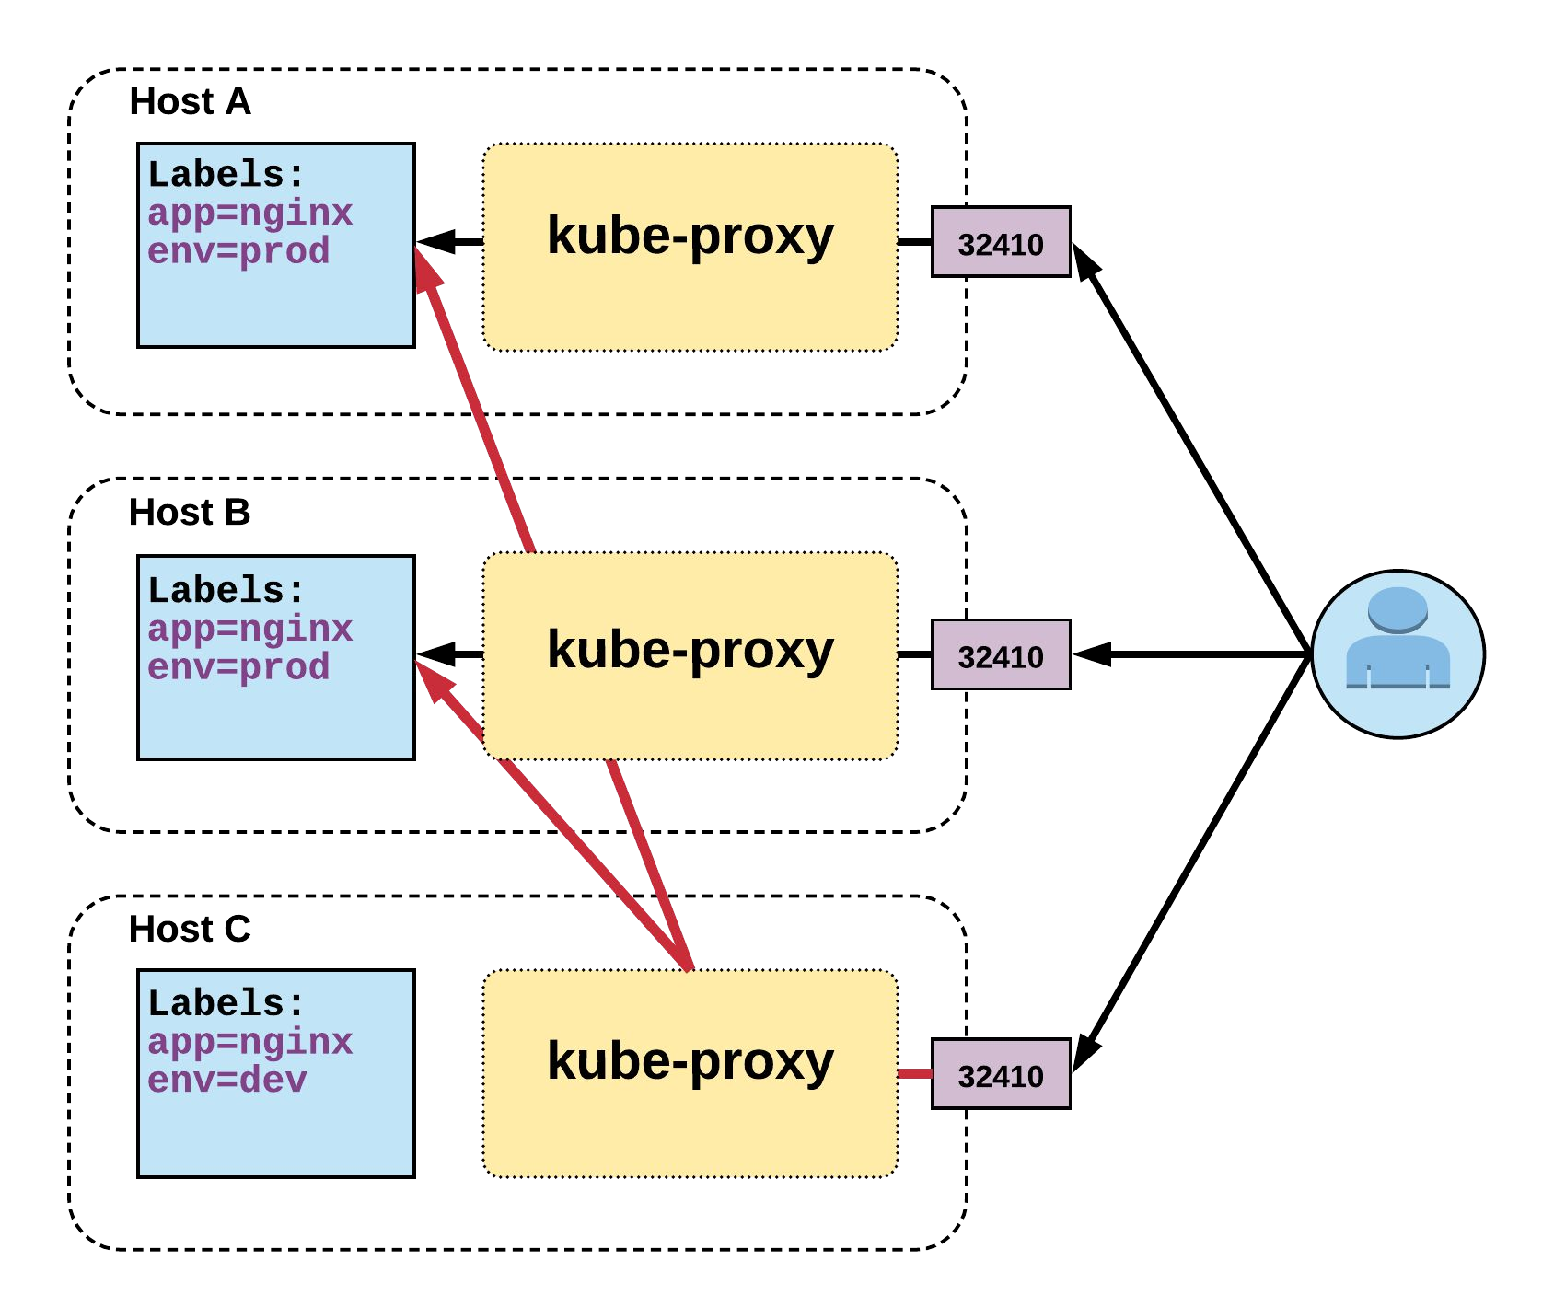
NodePort Service
Name: Selector: Type:
IP:
Port: TargetPort: NodePort: Endpoints:
example-prod app=nginx,env=prod NodePort 10.96.28.176
<unset> 32410/TCP 80/TCP
10.255.16.3:80,
10.255.16.4:80

Slide 49
LoadBalancer Service
apiVersion: v1 kind: Service metadata:
name: example-prod spec:
type: LoadBalancer selector:
app: nginx env: prod
ports:
protocol: TCP port: 80
targetPort: 80
LoadBalancer services extend NodePort
Works in conjunction with an external system to map a cluster external IP to the exposed service
Notes:
LoadBalancer: Exposes the Service externally using a cloud provider’s load balancer. NodePort and ClusterIP Services, to which the external load balancer routes, are automatically created.

Slide 50
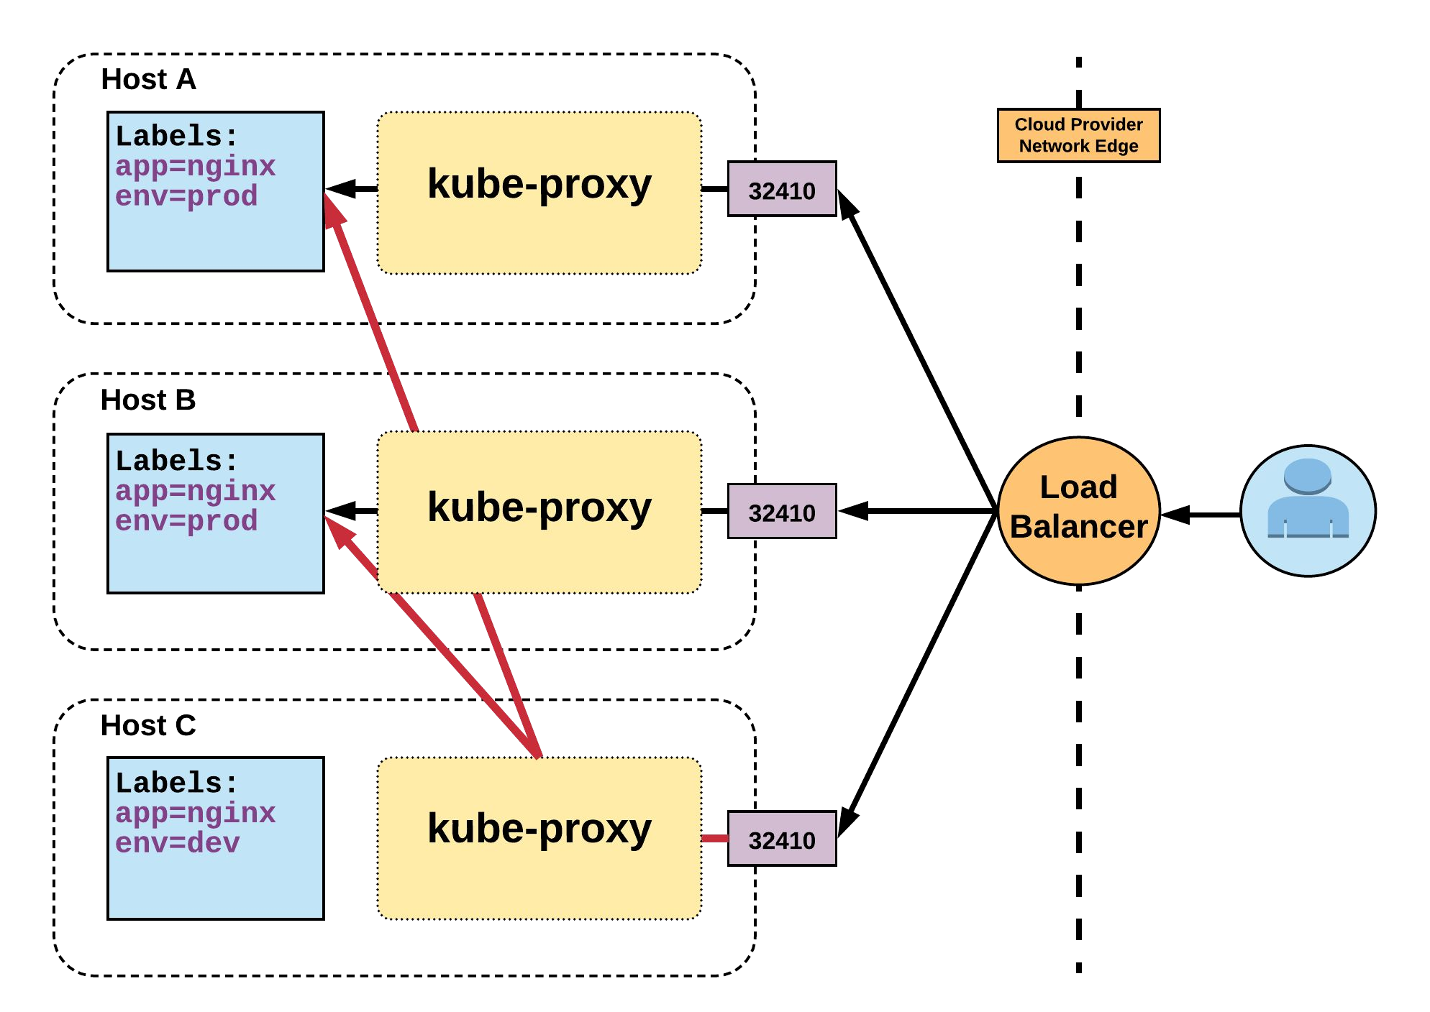
LoadBalancer Service
Name: Selector: Type:
IP:
LoadBalancer Ingress: Port: TargetPort: NodePort: Endpoints:
example-prod app=nginx,env=prod LoadBalancer 10.96.28.176
172.17.18.43
<unset> 80/TCP 80/TCP
<unset> 32410/TCP 10.255.16.3:80,
10.255.16.4:80

Slide 51
ExternalName Service
apiVersion: v1 kind: Service metadata:
name: example-prod spec:
type: ExternalName spec:
externalName: example.com
ExternalName is used to reference endpoints OUTSIDE the cluster
Creates an internal CNAME DNS entry that aliases another
Notes:
ExternalName: Maps the Service to the contents of the externalName field (e.g. foo.bar.example.com), by returning a CNAME record with its value. No proxying of any kind is set up.

Slide 52
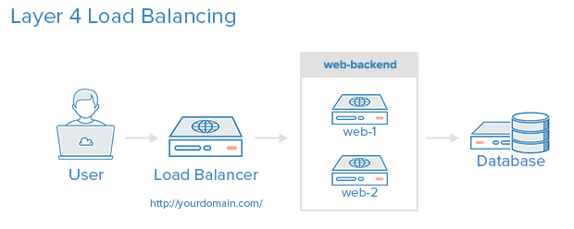
Layer 4 Load Balancing
Operates at Layer 4 of the ISO model (TCP)
Uses a DNS name or IP address as the advertised endpoint for the user/client
Can translate the IP address to forward a request to one or more backend services (load balancing)

Slide 53
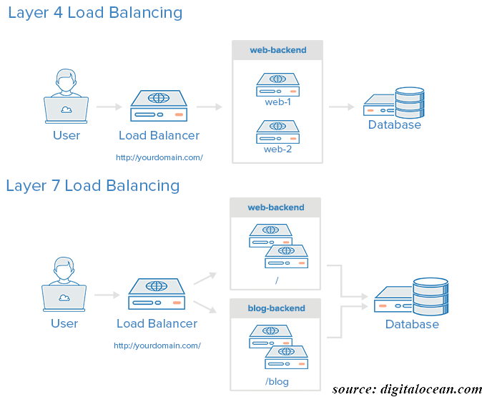
Layer 7 Load Balancing
Operates at the application layer - Layer 7 of the ISO model (HTTP)
More “expensive” in time and resource to process
Can inspect the HTTP header content to forward a request
Allows for more advanced use cases such as “Path based routing”

Slide 54
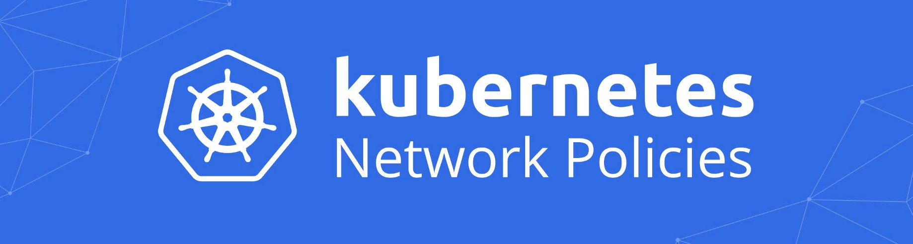
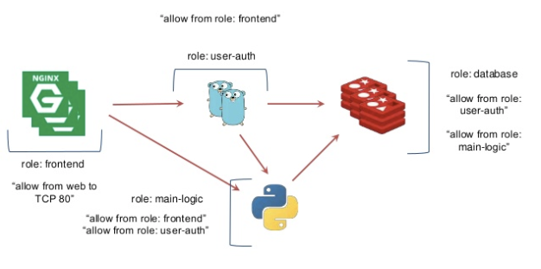
Network Policies
A network policy is a specification of how groups of pods are allowed to communicate with each other and other network endpoints.¹
By default all pods can talk to one another in a cluster without restriction.
A network provider that supports policies is needed allowing you to take advantage of this capability.
Network policies are one area of implementing security controls in your kubernetes cluster.
2
¹www.kubernetes.io
²https://www.projectcalico.org/

Slide 55
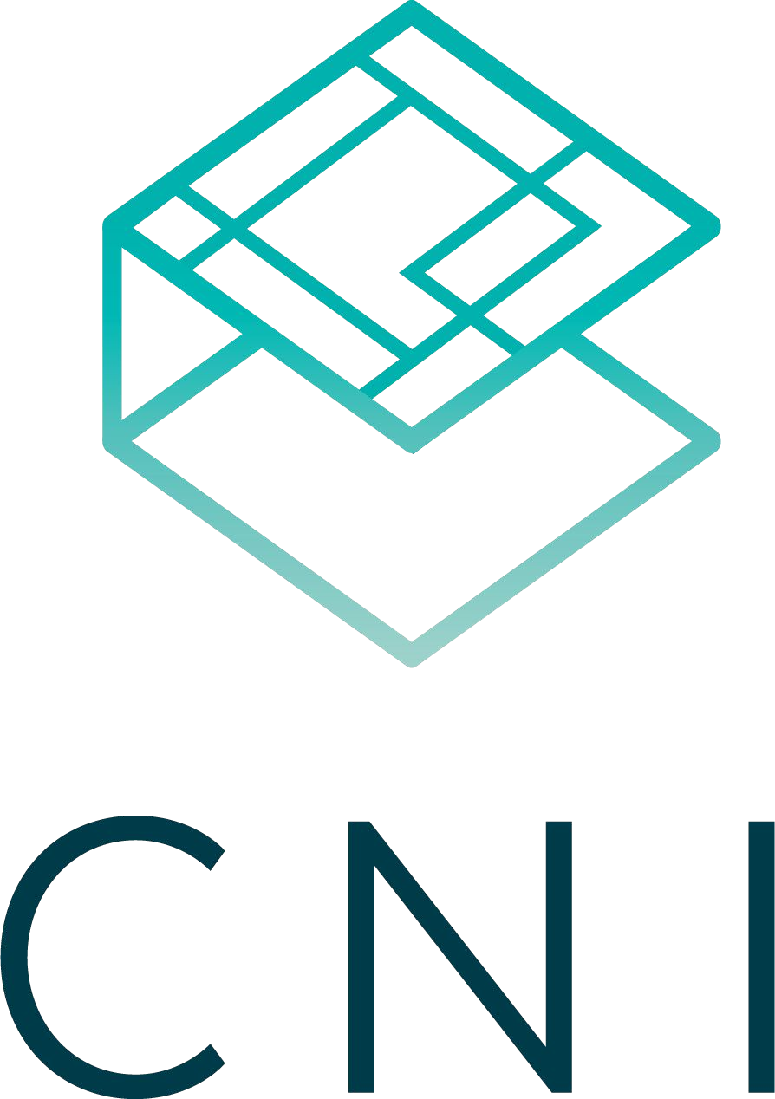
Container Network Interface (CNI)
Container Network Interface (CNI) is an open source project that is focused on establishing a standard specification for integrating containers with network providers
Using the specification, network vendors and community members have created plugins to a variety of networking systems
https://github.com/containernetworking/cni
Notes:
A CNI plugin is responsible for inserting a network interface into the container network namespace (e.g. one end of a veth pair) and making any necessary changes on the host (e.g. attaching the other end of the veth into a bridge). It should then assign the IP to the interface and setup the routes consistent with the IP Address Management section by invoking appropriate IPAM plugin.

Slide 56





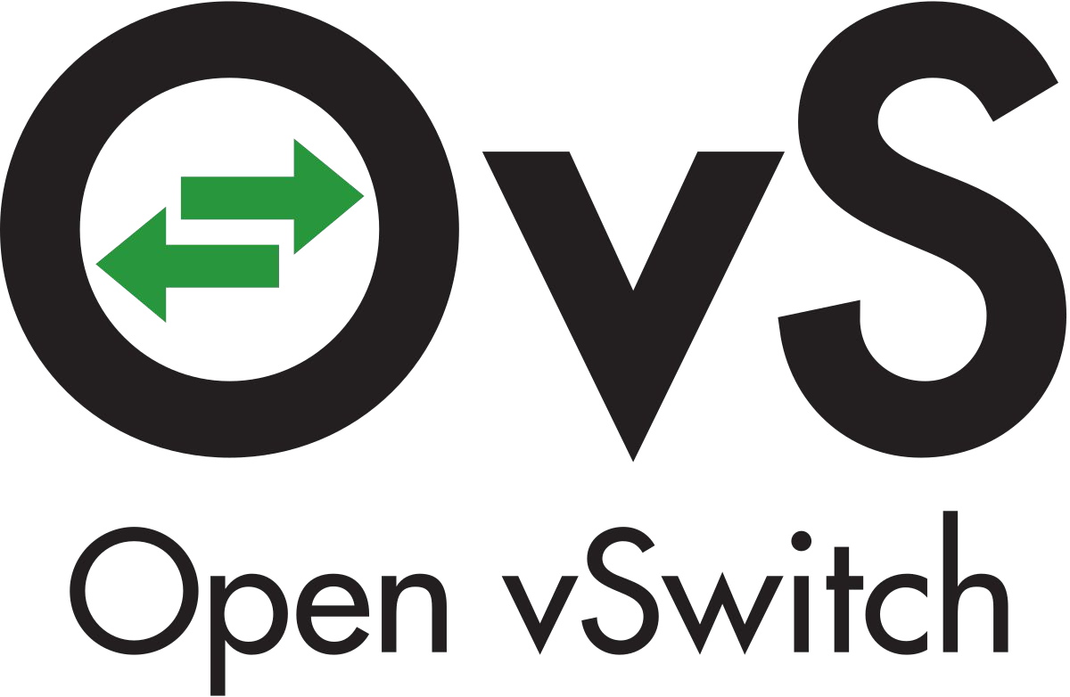
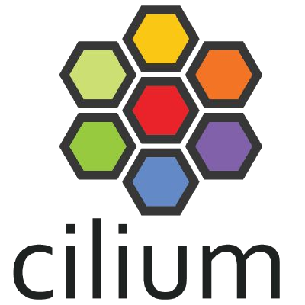
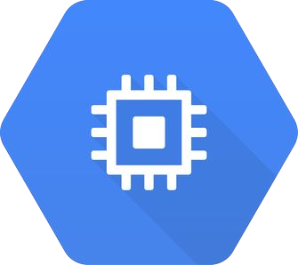



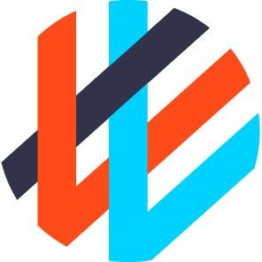
CNI Plugins
Amazon ECS
Calico
Cilium
Contiv
Contrail
Flannel
GCE
kube-router
Multus
OpenVSwitch
Romana
Weave

Slide 57
Kubernetes Networking
Hands On Labs
Expose a Kubernetes Application using a Service Type Load Balancer (L4)
Expose a Kubernetes Application using an Ingress (L7)
Leverage Network Policies to restrict access

Slide 58
Kubernetes Storage

Slide 59

Container Storage Interface (CSI)
Container Storage Interface (CSI) is an open source project that is focused on establishing a standard specification for integrating containers with storage providers
Using the specification, storage vendors and community members have created plugins to a variety of storage systems.
https://kubernetes-csi.github.io/docs/drivers.html
Notes:
An industry standard “Container Storage Interface” (CSI) that will enable storage vendors (SP) to develop a plugin once and have it work across a number of container orchestration (CO) systems.

Slide 60
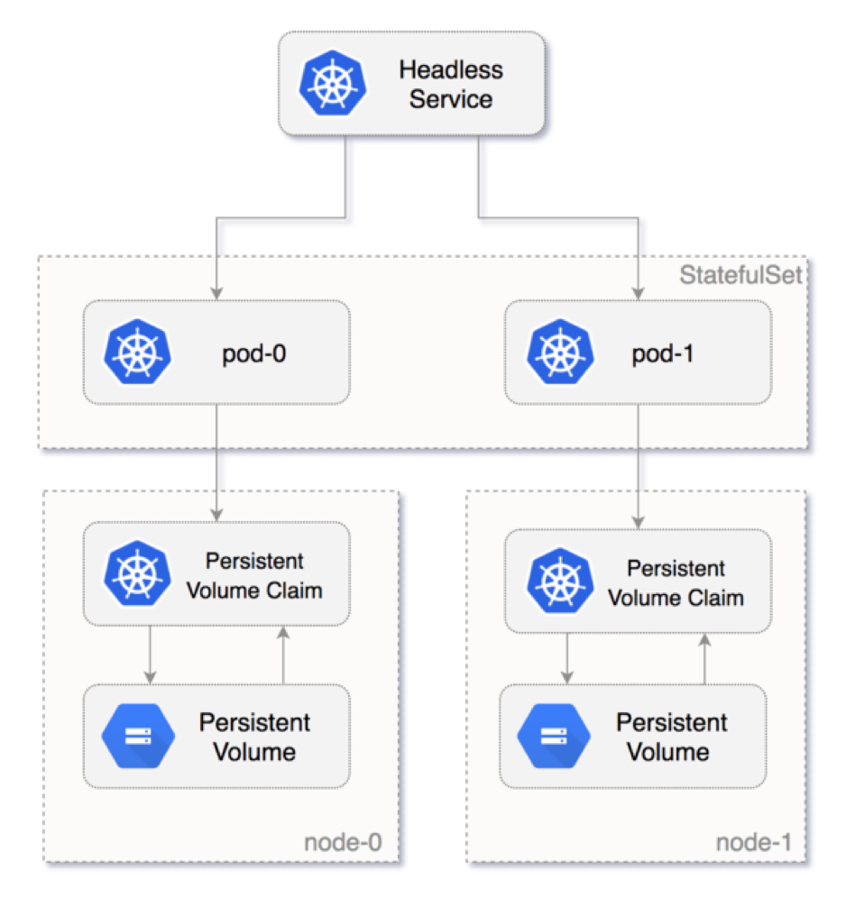
Storage Concepts
Pods by themselves are useful, but many workloads require exchanging data between containers, or persisting some form of data.
For this we have Volumes, PersistentVolumes, PersistentVolumeClaims, and StorageClasses.

Slide 61
Storage Volumes
Storage that is tied to the Pod’s Lifecycle
A pod can have one or more types of volumes attached to it
Can be consumed by any of the containers within the pod
Survive Pod restarts; however their durability beyond that is dependent on the Volume Type
Notes:
A Kubernetes volume, has an explicit lifetime - the same as the Pod that encloses it. Consequently, a volume outlives any Containers that run within the Pod, and data is preserved across Container restarts. Of course, when a Pod ceases to exist, the volume will cease to exist, too. Perhaps more importantly than this, Kubernetes supports many types of volumes, and a Pod can use any number of them simultaneously.

Slide 62
Persistent Volumes
A PersistentVolume (PV) represents a storage resource
PVs are a cluster wide resource linked to a backing storage provider: NFS, GCEPersistentDisk, EBS volume, etc.
Generally provisioned by an administrator
Their lifecycle is handled independently from a pod
CANNOT be attached to a Pod directly. Relies on a PersistentVolumeClaim
Notes:
A PersistentVolume (PV) is a piece of storage in the cluster that has been provisioned by an administrator or dynamically provisioned using Storage Classes. It is a resource in the cluster just like a node is a cluster resource. PVs are volume plugins like Volumes, but have a lifecycle independent of any individual pod that uses the PV. This API object captures the details of the implementation of the storage, be that NFS, iSCSI, or a cloud-provider-specific storage system.

Slide 63
Persistent Volume Claims
A PersistentVolumeClaim (PVC) is a namespaced request for storage
Satisfies a set of requirements instead of mapping to a storage resource directly
Ensures that an application’s ‘claim’ for storage is portable across numerous backends or providers
Notes:
A PersistentVolumeClaim (PVC) is a request for storage by a user. It is similar to a pod. Pods consume node resources and PVCs consume PV resources. Pods can request specific levels of resources (CPU and Memory). Claims can request specific size and access modes (e.g., can be mounted once read/write or many times read-only).

Slide 64
StorageClass
Storage classes are an abstraction on top of an external storage resource (PersistentVolume)
Work hand-in-hand with the external storage system to enable dynamic provisioning of storage
Eliminates the need for the cluster admin to pre-provision a PV
Notes:
A StorageClass provides a way for administrators to describe the “classes” of storage they offer. Different classes might map to quality-of-service levels, or to backup policies, or to arbitrary policies determined by the cluster administrators. Kubernetes itself is unopinionated about what classes represent. This concept is sometimes called “profiles” in other storage systems.

Slide 65
StatefulSet
Tailored to managing Pods that must persist or maintain state
Pod identity including hostname, network, and storage WILL be persisted
Pod lifecycle will be ordered and follow consistent patterns
Notes:
StatefulSet is the workload API object used to manage stateful applications. Like a Deployment , a StatefulSet manages Pods that are based on an identical container spec. Unlike a Deployment, a StatefulSet maintains a sticky identity for each of their Pods. These pods are created from the same spec, but are not interchangeable: each has a persistent identifier that it maintains across any rescheduling.

Slide 66
Kubernetes Storage
Hands On Labs
Leverage persistent storage using Container Storage Interface
AWS EBS CSI Driver

Slide 67
Kubernetes Services and Operators

Slide 68

Helm
Helm is an open source project that helps you manage Kubernetes applications using “Charts”. Like other projects, Helm is an add-on to Kubernetes that needs to be deployed.
Charts help describe deployment of complex services. It has 2 parts:
Helm - the client
Tiller - the server
Helm relies on a backend repository for access to the charts.

Slide 69
Operator Pattern
Operators are:
A pattern for extending the Kubernetes API to manage the lifecycle of complex services
Primarily written in Go
May be implemented with a variety of approaches without a broad set of standards
Needed to support the lifecycle management of a service
Distributed systems
Complex applications
Stateful/data services (databases, caches, datastores)

Slide 70

Kudo
Open source project led by D2iQ
Aimed at simplifying the development process of production grade operators
Operator is defined in YAML (declarative) and uses standard kubernetes components
(API, etcd, kubectl, …)
Defines a standard for Day 2 operations, production grade quality, and consistency for user experience
https://kudo.dev/
Kafka CRD
Cassandra CRD
MySQL CRD
KUDO Controller
Kubernetes API
etcd
KUDO provides a declarative approach to building full-lifecycle Kubernetes app operators

Slide 71
Kubernetes Services and Operators
Hands On Labs
Deploy a service using Helm charts
Deploy Kafka using KUDO

Slide 72
Kubernetes Operations and Observability

Slide 73
Lifecycle Management Considerations
Cluster Scaling:
Adding node capacity
Cluster Upgrades and Patching:
Rolling updates of your kubernetes version
Upgrades and Patching also applies to required
add-ons to your cluster (dns, ingress controller, etc.)

Slide 74
Kubernetes Cluster Operations
Hands On Labs
Scale a Konvoy cluster
Upgrade a Konvoy cluster

Slide 75
Observability Concepts
APIs that provide counters, gauges or other statistics
Can be used to detect health, capacity and other useful measures
Metrics
Logging
Messages or text that describe what is happening
Can be used to observe and debug systems or applications
Tracing
Provides visibility between components in a distributed system
Can be used to profile or debug systems or applications when it is needed to see what is happening between components.

Slide 76
Kubernetes Observability
Hands On Labs
Konvoy Monitoring Lab
Konvoy Logging/Debugging Lab

Slide 77
What next?

Slide 78




D2iQ – Smarter Day 2 Operations
Your Partner in the Cloud Native Journey
TECHNOLOGY
TRAINING
SERVICES
SUPPORT
Enterprise Grade Kubernetes
DC/OS
Konvoy
KUDO
Data Service Operators
Kommander
CNCF Certified Training Partner
Cloud Native Workshops
DC/OS Operational and Developer Training
Kubernetes Fundamentals and Advanced Training
Kubernetes Developer Training
CNCF Certified Service Provider
Cloud Native Roadmap Service
Konvoy/Kubernetes Jumpstart and Accelerators
Cloud Native Services Engineering
Application Modernization
Cloud Native Services Support
24/7 Operational Support for Wide Range of Prevailing Cloud Native Services
Resident Support Services
Mixed Workload Testing for Resilience and Scale

Slide 79
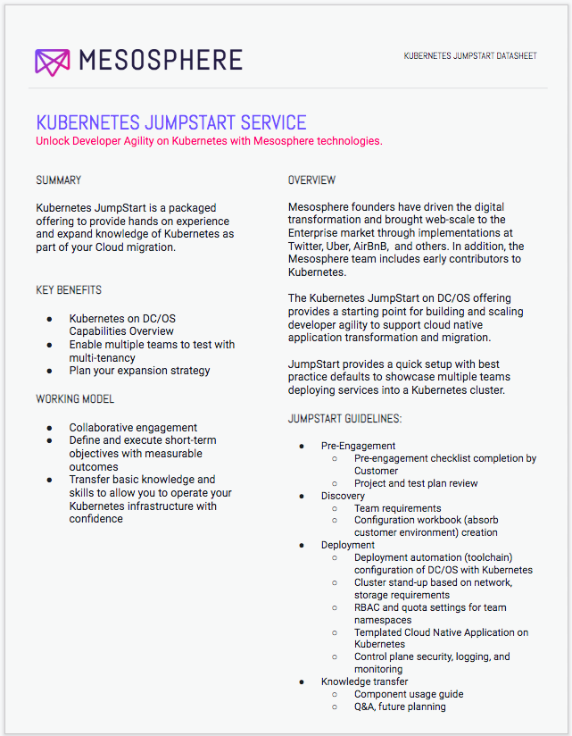
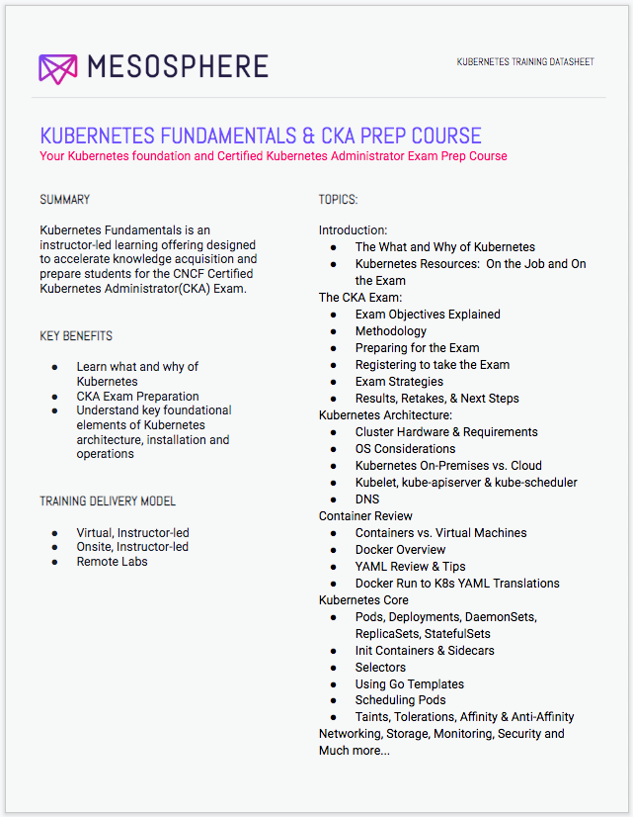
Operationalizing Kubernetes
Enablement & Expertise for teams on Kubernetes:
Kubernetes Fundamentals & Certified Kubernetes Admin Prep Course (CKA)
Kubernetes Certified Developer Prep Course (CKAD)
Custom Training & Workshops for your specific needs
Resident Consultant (onsite) for operational & developer support
Access to key D2iQ Kubernetes experts to:
Review configuration, installation and architectural options
Review and shares strategies for scalability and performance testing
Improve operational practices

Slide 80
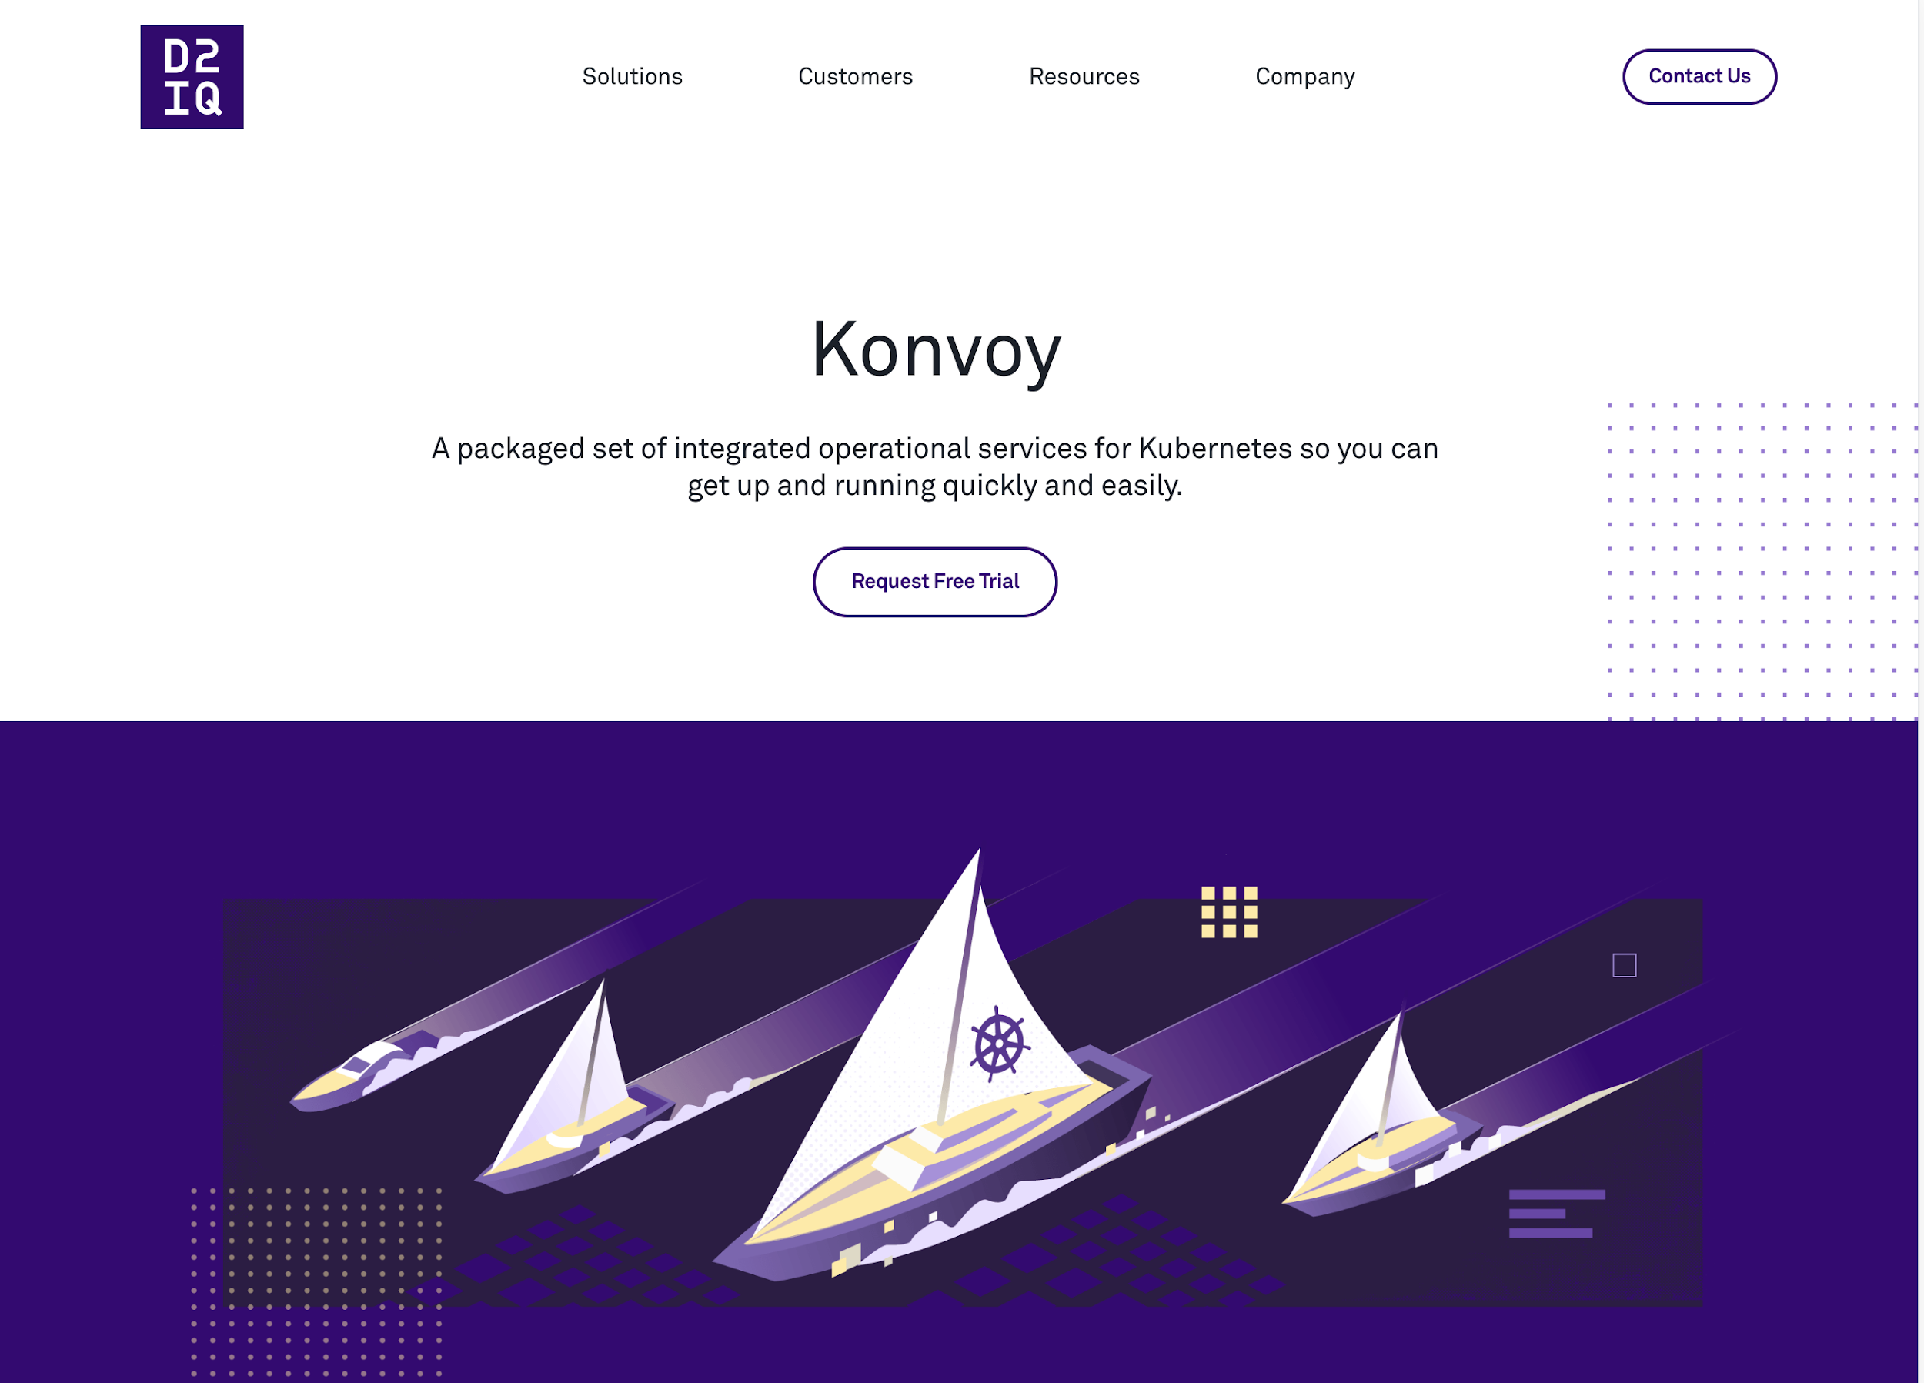
Konvoy Trial
Download Konvoy for a free 90-day Trial
Engage with D2iQ Field Engineer to deploy
https://d2iq.com/solutions/ksphere/konvoy
https://docs.d2iq.com/ksphere/konvoy/latest/introduction/

Slide 81



Onsite Workshop
D2iQ Kubernetes Workshop Onsite

Slide 82
Thanks for Coming

Slide 83
Training Location and Docs
Lab Location:
https://github.com/mesosphere/konvoy-training
Student Info:
https://docs.google.com/location

